Slide 1
Optimal Train Scheduling Problem
Researcher: Kajal Chokshi
Mentor: Dr. Grace Guo
DIMACS REU Summer 2016
Funded by NSF, Data by Union Pacific

Slide 2
Overview
Scheduling trains on single tracks depending on various constraints
  Various constraints include types of cargo, time of travel, etc.
  Optimize train schedule in order to minimize cost and delay

Slide 3
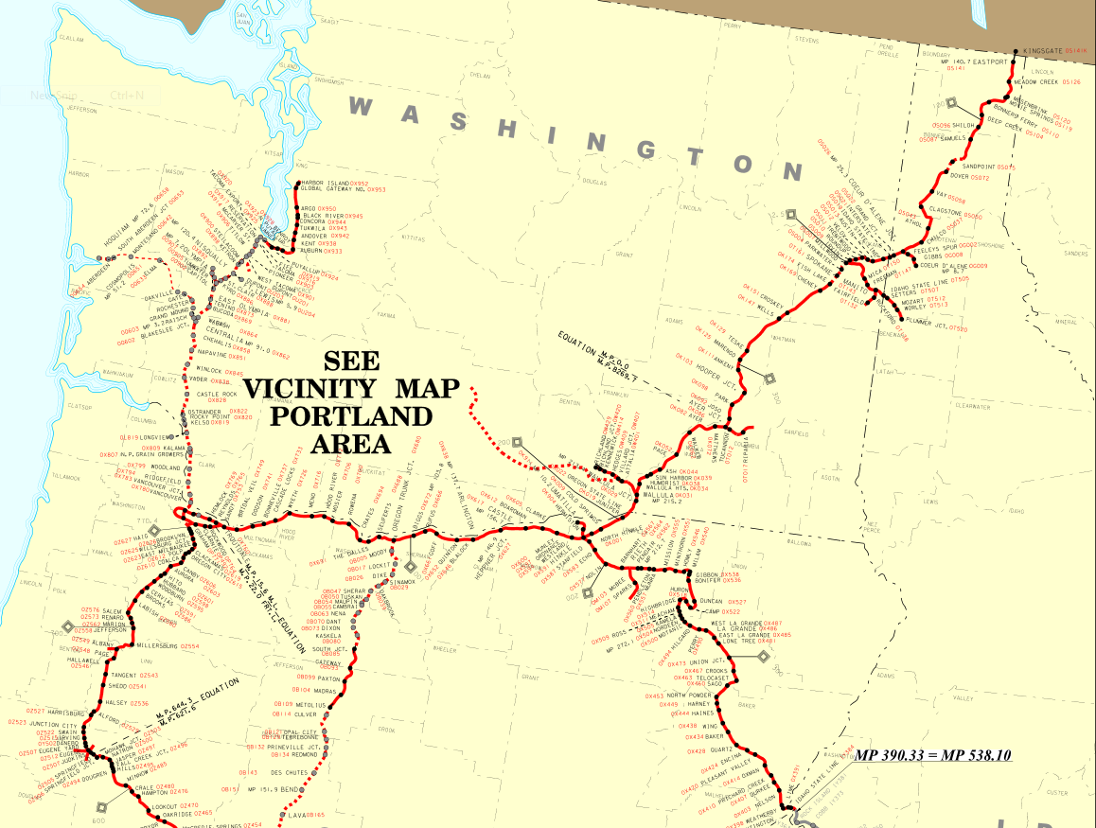
Given Information
Dataset from a company regarding single track train schedules
Approximately 250K records for 6 weeks of data
Background information regarding optimization

Slide 4
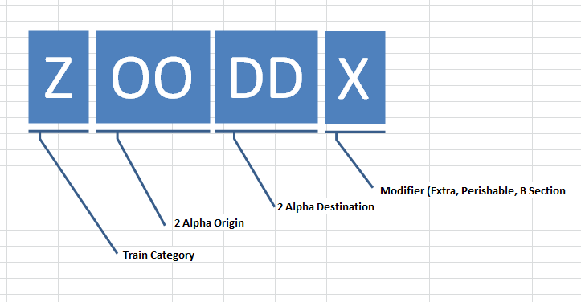
Dataset
Ex.
Train Symbol: ACYBAX
Train Category: Auto
Alpha Origin: Cheyenne
Alpha Destination: Barnes
Modifier: Extra

Slide 5
Research Goals
Visualize the data using R programming
Understand how to build a probability distribution to generate data for simulation
Optimize train schedule to minimize delay and cost
Notes:
Visualize using SAS programming such as bar charts of trains on different days, times, types of trains
Generate data for simulation to create different scenarios
Minimize delay and cost using the branch and bound procedure

Slide 6
Methods
Visualization through R Programming
Analysis of plots and bar graphs
Create an Empirical Distribution

Slide 7
Visualization
3 different layers
  Each layer is a subset of the previous layer
  Helps understand trends and patterns

Slide 8
Primary Layer
Total of 1 graph
Purpose: To show train behavior on each day of the week
Maximum- Thursday
Minimum- Sunday
Later end of weekdays tend to have most trains
Sunday Monday Tuesday Wednesday Thursday Friday Saturday
Notes:
Purpose: To visualize the different number of unique trains on each day of the week
Based on this layer we see that each day of the week is different regarding the number of unique trains therefore we need to subset the data further by the hours of the day

Slide 9
Secondary Layer
Total of 7 graphs
Purpose:
To visualize the behavior of trains on an hourly basis
Sunday Train does not follow normal distribution, skewed left slightly
Most activity between 1 A.M. and 2 A.M.
Least activity between 10 A.M. and 11 P.M. followed by 5 A.M. and 6 A.M.
Notes:
Purpose: visualizing the trains on an hourly basis so we can learn to mimic the real life data for our simulation
(peak of day and rush hour)

Slide 10
Secondary Layer
Graph 2 of 7
Most evenly distributed day
Most activity between 9 A.M. and 10 A.M.
Least activity between 3 P.M. and 4 P.M. followed by 7 A.M. and 8 A.M. (people coming home and rush hour)
Notes:
Want to mimic the actual train behavior in my probability model and to do that we want to know more about the real train
-need to know if the days are the same of the week
-from the first layer we don’t see a uniform distribution, the trains on different days of the week are different
-address each day
-we look at each day and we see they are different on a hourly basis
-so we want to create a distribution that would generate data that looks like this

Slide 11
Secondary Layer
Graph 3 of 7
Relatively normal distribution
Most activity between 1 P.M. and 2 P.M.
Least activity between 8 A.M. and 9 A.M. followed by 4 P.M. and 5 P.M. (rush hour and individuals driving home)

Slide 12
Secondary Layer
Graph 4 of 7
Wednesday Train follows a closer normal distribution
Most activity between 11 A.M. and 12 P.M.
Least activity between 6 A.M. and 7 A.M. followed by 3 P.M. and 4 P.M.

Slide 13
Secondary Layer
Graph 5 of 7
Relatively normal distribution
Most activity between 12 A.M. and 1 A.M.
Least activity between 4 A.M. and 5 A.M.

Slide 14
Secondary Layer
Graph 6 of 7
Friday Train follows a closer normal distribution
Most activity between 11 A.M. and 12 P.M.
Least activity between 6 A.M. and 7 A.M.

Slide 15
Secondary Layer
Graph 7 of 7
Relatively normal distribution
Most activity between 3 A.M. and 4 A.M.
Least activity between 5 A.M. and 6 A.M.

Slide 16
Secondary Layer Trends
Most activity tends to be in the very early morning or at noon
Least activity tends to be during rush hour and the mid afternoon
Saturday and Sunday have the most common trends

Slide 17
Tertiary Layer
Subset data by Cargo Type
Total of 168 graphs
Notes:
The cargo type explains the priority of the train
Total of 168 graphs because we take 7 days subset by each hour (24 hours) and make a graph for each hour

Slide 18
Tertiary Layer
Example: Sundays from 1:00 A.M. to 2:00 A.M.
Most cargo type: Manifest
Least cargo type: Intermodal and Passenger

Slide 19
Tertiary Level Summary
Thursday:
  Most common cargo type: Manifest
  Least common cargo type: Passenger
Friday:
  Most common cargo type: Manifest
  Least common cargo type: Passenger, Special,
Saturday:
  Most common cargo type: Manifest
  Least common cargo type: Passenger and Special
Sunday:
  Most common cargo type: Manifest
  Least common cargo type: Intermodal and Passenger
Monday:
  Most common cargo type: Manifest and Local
  Least common cargo type: Passenger and Special
Tuesday:
  Most common cargo type: Local
  Least common cargo type: Passenger and Special
Wednesday:
  Most common cargo type: Local
  Least common cargo type: Passenger and Special

Slide 20
Tertiary Level Trends
The type of cargo trains to focus on regarding simulating data would be
  Manifest
  Local
The type of cargo trains to disregard would be
  Passenger
  Special
Notes:
Highest priority would be for manifest or local trains

Slide 21
Empirical Distribution
Empirical distributions are defined by the data
It follows an inverse transformation method
Random values are generated during the simulation rather than fitting a theoretical model
Notes:
This is not a model/distribution we know, therefore we must create an empirical distribution
We need to make an empirical distribution because of this

Slide 22
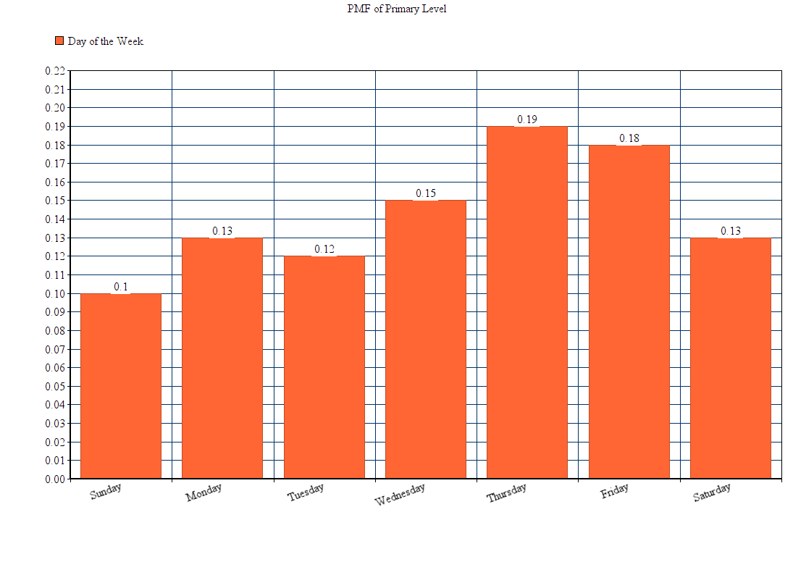
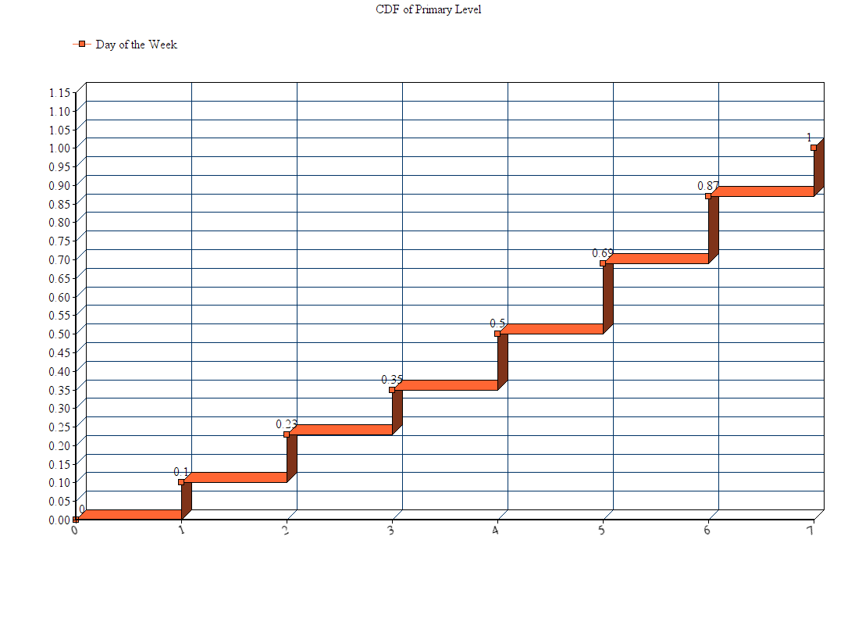
Primary Level PMF to CDF
Notes:
Take this data and convert it to a cdf which is in progress
*Create a pmf and cdf chart

Slide 23
Discussion and Conclusion
Continuing research using the empirical model
Generate data for simulation to no longer require physical data from corporations
Notes:
After generating data, want to see if the simulated data agrees with the real data
If not, we need to go to a fourth layer, if it does, then we can use it to generate data and drive simulation
We will know after we finish this analysis

Slide 24
Neither a wise man nor a brave man lies down on the tracks of history to wait for the train of the future to run over him.
~Dwight D. Eisenhower
Acknowledgements:
National Science Foundation
DIMACS and Rutgers
Dr. Grace Guo

Slide 25
References
    A. Higgins
    Optimal Scheduling of Trains On a Single Line Track
    Ph.D. Thesis, Faculty of Science, Queensland University of Technology (1996)
    A. Higgins
    Modelling the Number and Location of Sidings on a Single Line Railway
    Ph.D. Thesis, Faculty of Science, Queensland University of Technology (1997)
    Union Pacific Trainline Dataset

